Slide 1
Science of Star Wars
Choose a planet from the Star wars universe at the end of the power point.
Use the info on the planet to complete all 7 challenges.
Save in the student share T:\~Remote Learning~\Mr Sheelan\Star Wars Entries or email to Info@st-hildas.co.uk for the attention of Mr Sheelan. May the force be with you

Slide 2
Starter
https://www.youtube.com/watch?v=Q0CbN8sfihY
What do you know about the planets and moons in the star wars universe

Slide 3
Choose a planet or moon
You are an intergalactic explorer/Jedi investigating the planets and moon of star wars before the events of the movies
You must complete the challenges assigned to you

Slide 4
Challenge 1: Design a creature suitable to live on your planet – label any adaptations it has to live there (what does the creature do) – be creative don’t create an already existing character
Challenge 2: build and design a vehicle that would be suitable for planetary (or lunar) exploration. Does it have any instruments to help you discover more about the planets surface

Slide 5
Challenge 3: you discover a new molecule in your explorations – build it using the molecular model kits and give it an appropriate name
Challenge 4: you decide to colonise your planet or moon – design or build the shelters you will live in where on your planet or moons surface will you place your settlement

Slide 6
Challenge 5: you have lived in your settlement for a while when some of your inhabitants become sick from a mysterious illness – you must study it and work out what it is and what the symptoms are, is there a cure?
Challenge 6: name your settlements ruling party – design it’s insignia and write it’s manifesto

Slide 7
Challenge 7: design and build a droid to help you out in your settlement – what features does it have to help

Slide 8
3) Molecule and name:
4) Shelter design and location:
1) Creature design and description:
Star
Wars
science
2) Vehicle design and description:
5) Disease name, cause and symptoms

Slide 9
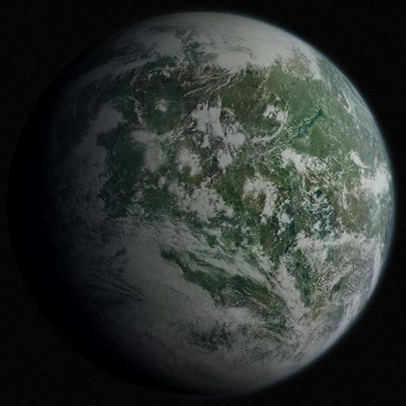
Dagobah
Diameter
14,410 kilometers^{[3]}
Atmosphere
Violent lightning storms, dense fog^{[2][1]}
Climate
Periods of torrential rainfalls^{[2][1]}
Primary terrain
Swamp^{[2]}
Bogs^{[2]}
Wetlands^{[2]}

Slide 10
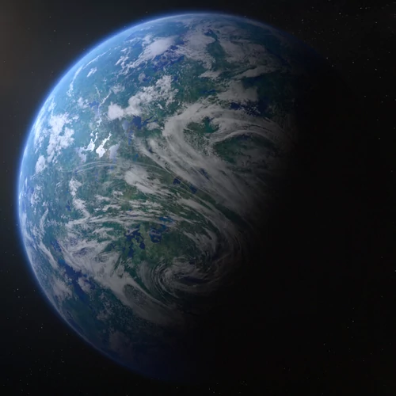
Endor
Diameter
4,900 km^{[3]}
Atmosphere
Breathable to humans^{[4]}
Primary terrain
Forests^{[4]}, savannas,^{[1]}mountains^{[1]}
Surface water
8%^{[3]}

Slide 11
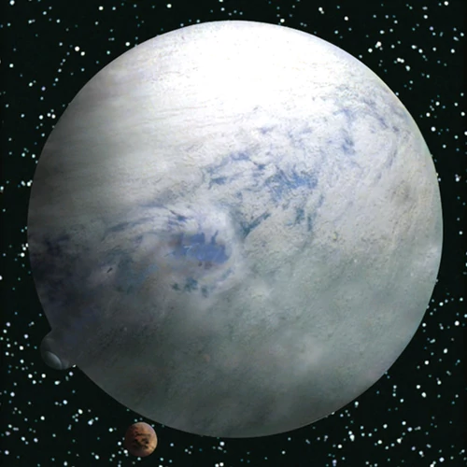
Hoth
Class
Terrestrial^{[6]}
Diameter
7,200 km^{[7]}
Atmosphere
Breathable to Humans^{[6]}
Climate
Frigid^{[3]}
Primary terrain
Frozen ice plains, glaciers^{[3]}, mountains^{[8]}
Surface water
33% (Oceans)^{[7]}

Slide 12
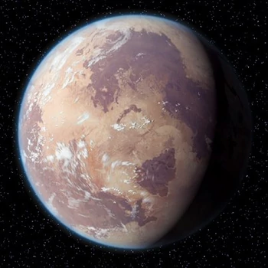
Tatooine
Class
Terrestrial
Diameter
10,465 km^{[3]}
Atmosphere
Breathable to humans^{[5]}
Climate
Hot and arid^{[1]}
Primary terrain
Desert,^{[5]} canyons, rocky bluffs^{[1]}
Surface water
1%^{[3]}

Slide 13
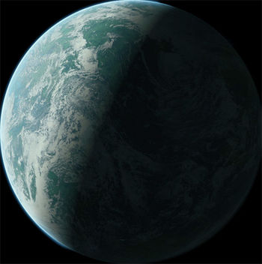
Naboo
Class
Terrestrial^{[7]}
Diameter
12,120 kilometers^{[6]}
Atmosphere
Breathable^{[7]}
Climate
Temperate^{[8]}
Primary terrain
Swamps^{[9]}
Hills^{[9]}
Plains^{[9]}
Cities^{[9]}
Mountains^{[6]}

